Slide 1
CPSC3300: Computer Systems Organization
Lectures 14 & 15 – Instruction Level Parallelism

Slide 2
Overview
Instruction level parallelism
Multiple issue
Dynamic scheduling
out-of-order execution
Reading
Chp. 4.10

Slide 3
Instruction-Level Parallelism (ILP)
Pipelining: executing multiple instructions in parallel
Basic pipeline
To increase ILP
Deeper pipeline
Less work per stage ⇒ shorter clock cycle
Multiple issue
Replicate pipeline stages ⇒ multiple pipelines
Start multiple instructions per clock cycle
CPI < 1, so use Instructions Per Cycle (IPC). IPC > 1
E.g., 4GHz 4-way multiple-issue
16 Billions Ins. Per Second, peak CPI = 0.25, peak IPC = 4
But dependencies reduce this in practice

Slide 4
Multiple Issue
Static multiple issue
Compiler groups instructions to be issued together
Packages them into “issue slots”
Instruction in the same slot are issued on the same cycle
Compiler detects and avoids hazards
Dynamic multiple issue
CPU examines instruction stream and chooses instructions to issue each cycle
Compiler can help by reordering instructions
CPU resolves hazards using advanced techniques at runtime

Slide 5
Speculation
“Guess” what to do with an instruction
Start operation as soon as possible
Check whether guess was right
If so, complete the operation
If not, roll-back and do the right thing
Common to static and dynamic multiple issue
Examples
Speculate on branch outcome
Roll back if path taken is different
Speculate on load
Roll back if location is updated

Slide 6
Compiler/Hardware Speculation
Compiler can reorder instructions
e.g., move load before branch
Can include “fix-up” instructions to recover from incorrect guess
Hardware can look ahead for instructions to execute
Buffer results until it determines they are actually needed
Flush buffers on incorrect speculation

Slide 7
Static Multiple Issue
Compiler groups instructions into “issue slots”
Group of instructions that can be issued on a single cycle
Determined by pipeline resources required
Think of an issue slot as a very long instruction
Specifies multiple concurrent operations
⇒ Very Long Instruction Word (VLIW)

Slide 8
Scheduling Static Multiple Issue
Compiler must remove some/all hazards
Reorder instructions into issue packets
No dependencies with a packet
Possibly some dependencies between packets
Varies between ISAs; compiler must know!
Pad with nop if necessary

Slide 9
MIPS with Static Dual Issue
Two-issue packets
One ALU/branch instruction (1st Ins)
One load/store instruction (2nd ins)
64-bit aligned
ALU/branch, then load/store
Pad an unused instruction with nop
Address | Instruction type | Pipeline Stages
n | ALU/branch | IF | ID | EX | MEM | WB
n + 4 | Load/store | IF | ID | EX | MEM | WB
n + 8 | ALU/branch |  | IF | ID | EX | MEM | WB
n + 12 | Load/store |  | IF | ID | EX | MEM | WB
n + 16 | ALU/branch |  |  | IF | ID | EX | MEM | WB
n + 20 | Load/store |  |  | IF | ID | EX | MEM | WB
Two ins in a packet
What is the ideal IPC?
2

Slide 10
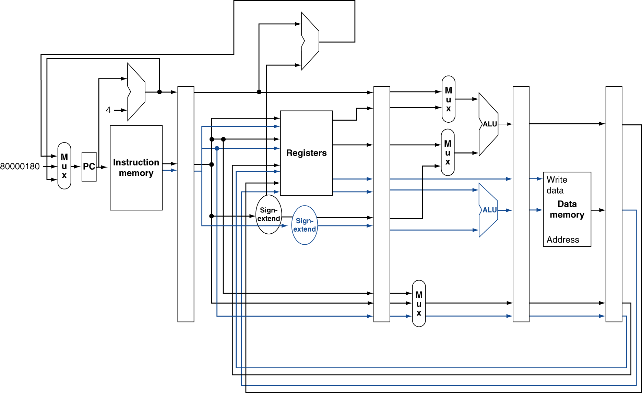
MIPS with Static Dual Issue
How is the basic pipeline changed?
Register: 4 read ports, 2 write ports
ALU: 1 -> 2

Slide 11
Hazards in the Dual-Issue MIPS
More instructions executing in parallel
EX data hazard
Forwarding avoided stalls with single-issue
Now can’t use ALU result in load/store in same packet
add $t0, $s0, $s1 load $s2, 0($t0)
Split into two packets, effectively a stall
Load-use hazard
Still one cycle use latency, but now two instructions
More aggressive scheduling required

Slide 12
Scheduling Example
Schedule this for dual-issue MIPS
Loop: lw $t0, 0($s1) # $t0=array element addu $t0, $t0, $s2 # add scalar in $s2 sw $t0, 0($s1) # store result addi $s1, $s1,–4 # decrement pointer bne $s1, $zero, Loop # branch $s1!=0
What are the data dependencies?
How to reorder the instructions to avoid pipeline stalls?
 | ALU/branch | Load/store | cycle
Loop: |  |  | 1
 |  |  | 2
 |  |  | 3
 |  |  | 4

Slide 13
Scheduling Example
Schedule this for dual-issue MIPS
Loop: lw $t0, 0($s1) # $t0=array element addu $t0, $t0, $s2 # add scalar in $s2 sw $t0, 0($s1) # store result addi $s1, $s1,–4 # decrement pointer bne $s1, $zero, Loop # branch $s1!=0
What are the data dependencies?
How to reorder the instructions to avoid pipeline stalls?
 | ALU/branch | Load/store | cycle
Loop: | nop | lw $t0, 0($s1) | 1
 | addi $s1, $s1,–4 | nop | 2
 | addu $t0, $t0, $s2 | nop | 3
 | bne $s1, $zero, Loop | sw $t0, 4($s1) | 4
IPC = 5/4 = 1.25 (c.f. peak IPC = 2)

Slide 14
Loop Unrolling for Large IPC
Replicate loop body to expose more parallelism
Reduces loop-control overhead
Use different registers per replication
Called “register renaming”
Avoid loop-carried “anti-dependencies”
Store followed by a load of the same register
Aka “name dependence”
Reuse of a register name
EX:
Loop: lw $t0, 0($s1) # $t0=array element addu $t0, $t0, $s2 # add scalar in $s2 sw $t0, 0($s1) # store result addi $s1, $s1,–4 # decrement pointer bne $s1, $zero, Loop # branch $s1!=0
Unroll the loop and make four copies of the loop body

Slide 15
Loop Unrolling Example
 | ALU/branch | Load/store | cycle
Loop: | addi $s1, $s1,–16 | lw $t0, 0($s1) | 1
 | nop | lw $t1, 12($s1) | 2
 | addu $t0, $t0, $s2 | lw $t2, 8($s1) | 3
 | addu $t1, $t1, $s2 | lw $t3, 4($s1) | 4
 | addu $t2, $t2, $s2 | sw $t0, 16($s1) | 5
 | addu $t3, $t3, $s2 | sw $t1, 12($s1) | 6
 | nop | sw $t2, 8($s1) | 7
 | bne $s1, $zero, Loop | sw $t3, 4($s1) | 8
IPC = 14/8 = 1.75
Closer to 2, but at cost of registers and code size

Slide 16
Dynamic Multiple Issue
“Superscalar” processors
CPU decides whether to issue 0, 1, 2, … each cycle
Avoiding structural and data hazards
Avoids the need for compiler scheduling
Though it may still help
Code semantics ensured by the CPU

Slide 17
Dynamic Pipeline Scheduling
Allow the CPU to execute instructions out of order to avoid stalls (OOO execution)
But commit result to registers in order (in-order commit)
Avoid hazard
Example
lw $t0, 20($s2) addu $t1, $t0, $t2 sub $s4, $s4, $t3 slti $t5, $s4, 20

Slide 18
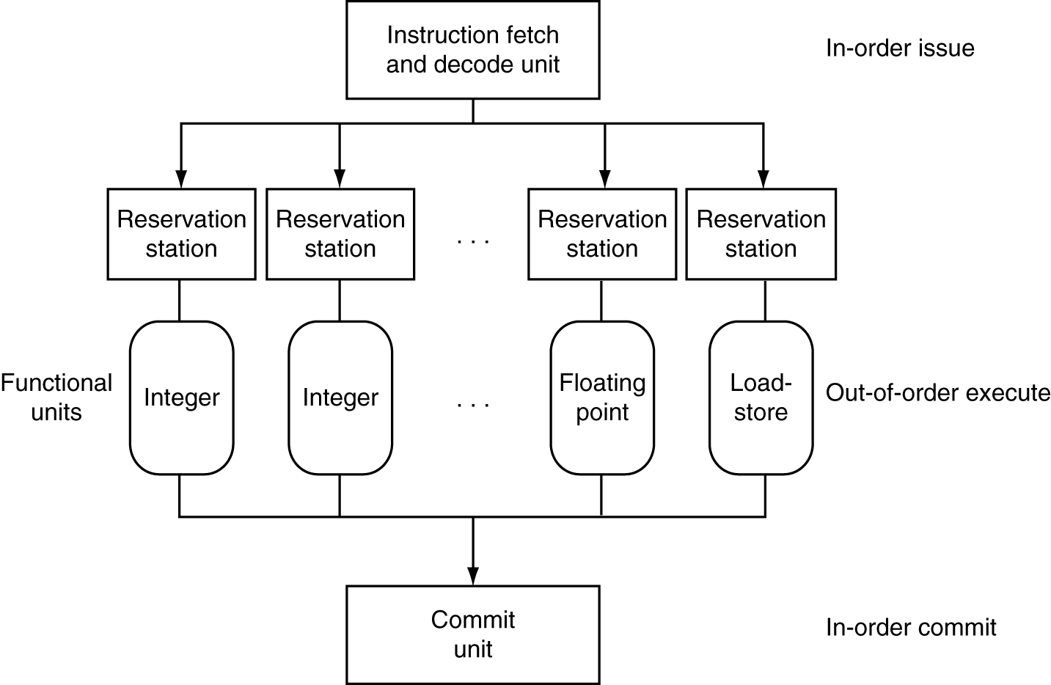
Dynamically Scheduled CPU
Preserves dependencies
Hold pending operands
Results also sent to any waiting reservation stations
Reorders buffer for register writes
Can supply operands for issued instructions

Slide 19
Power Efficiency
Complexity of dynamic scheduling and speculations requires power
Multiple simpler cores may be better
Microprocessor | Year | Clock Rate | Pipeline Stages | Issue width | Out-of-order/ Speculation | Cores | Power
i486 | 1989 | 25MHz | 5 | 1 | No | 1 | 5W
Pentium | 1993 | 66MHz | 5 | 2 | No | 1 | 10W
Pentium Pro | 1997 | 200MHz | 10 | 3 | Yes | 1 | 29W
P4 Willamette | 2001 | 2000MHz | 22 | 3 | Yes | 1 | 75W
P4 Prescott | 2004 | 3600MHz | 31 | 3 | Yes | 1 | 103W
Core | 2006 | 2930MHz | 14 | 4 | Yes | 2 | 75W
UltraSparc III | 2003 | 1950MHz | 14 | 4 | No | 1 | 90W
UltraSparc T1 | 2005 | 1200MHz | 6 | 1 | No | 8 | 70W

Slide 20
Why Do Dynamic Scheduling?
Why not just let the compiler schedule code?
Not all stalls are predicable
e.g., cache misses
Can’t always schedule around branches
Branch outcome is dynamically determined
Different implementations of an ISA have different latencies and hazards

Slide 21
Does Multiple Issue Work?
Yes, but not as much as we’d like
Programs have real dependencies that limit ILP
Some dependencies are hard to eliminate
e.g., pointer aliasing
Some parallelism is hard to expose
Limited window size during instruction issue
Memory delays and limited bandwidth
Hard to keep pipelines full
Speculation can help if done well

Slide 22
Concluding Remarks
ISA influences design of datapath and control
Datapath and control influence design of ISA
Pipelining improves instruction throughput using parallelism
More instructions completed per second
Latency for each instruction not reduced
Hazards: structural, data, control
Multiple issue and dynamic scheduling (ILP)
Dependencies limit achievable parallelism
Complexity leads to the power wall

